Slide 1
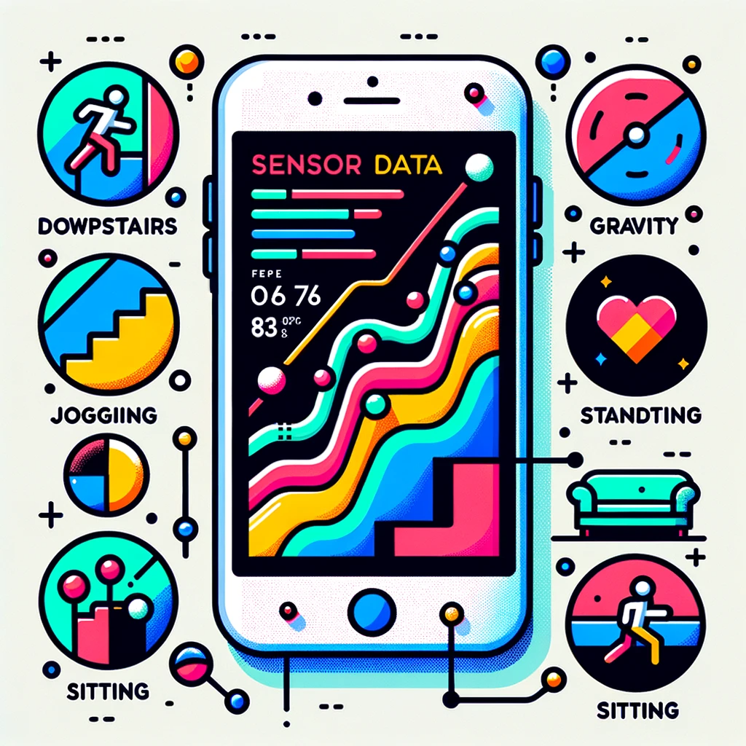
The MotionSense Dataset is a collection of time-series sensor data generated from accelerometer and gyroscope sensors on an iPhone 6s. The dataset is aimed at human activity and attribute recognition. It comprises data from 24 participants who performed 6 different activities: walking downstairs, walking upstairs, walking, jogging, sitting, and standing. The participants carried the phone in their front trouser pocket during the activities. The data consists of 15 trials with both long (2-3 minutes) and short (30 seconds to 1 minute) durations.
The dataset provides a rich set of features including attitude (roll, pitch, yaw), gravity (x, y, z), rotation rate (x, y, z), and user acceleration (x, y, z). It distinguishes between gravity and user acceleration, allowing for more accurate activity and attribute recognition. The dataset is intended for research in identifying personal attributes and different types of human activities.
This dataset serves as a valuable resource for those interested in activity recognition, sensor data analysis, and machine learning applications. If used, the authors request citing a specific paper.
Notes:
MotionSense Dataset : Smartphone Sensor Data - HAR (kaggle.com)
About Dataset
MotionSense Dataset: Sensor Based Human Activity and Attribute Recognition
Context
This dataset includes time-series data generated by accelerometer and gyroscope sensors (attitude, gravity, userAcceleration, and rotationRate). It is collected with an iPhone 6s kept in the participant's front pocket using SensingKit which collects information from Core Motion framework on iOS devices. A total of 24 participants in a range of gender, age, weight, and height performed 6 activities in 15 trials in the same environment and conditions: downstairs, upstairs, walking, jogging, sitting, and standing. With this dataset, we aim to look for personal attributes fingerprints in time-series of sensor data, i.e. attribute-specific patterns that can be used to infer gender or personality of the data subjects in addition to their activities.
A simple code for importing dataset and to get your hands in
Content
For each participant, the study had been commenced by collecting their demographic (age and gender) and physically-related (height and weight) information. Then, we provided them with a dedicated smartphone (iPhone 6) and asked them to store it in their trousers' front pocket during the experiment. All the participant were asked to wear flat shoes. We then asked them to perform 6 different activities (walk downstairs, walk upstairs, sit, stand and jogging) around the Queen Mary University of London's Mile End campus. For each trial, the researcher set up the phone and gave it to the current participants, then the researcher stood in a corner. Then, the participant pressed the start button of Crowdsense app and put it in their trousers' front pocket and performed the specified activity. We asked them to do it as natural as possible, like their everyday life. At the end of each trial, they took the phone out of their pocket and pressed the stop button. The exact places and routes for running all the activities are shown in the illustrative map in the following Figure.
As we can see, there are 15 trials:
Long trials: those with number 1 to 9 with around 2 to 3 minutes duration.
Short trials: those with number 11 to 16 that are around 30 seconds to 1 minutes duration.
There are 24 data subjects. The A_DeviceMotion_data folder contains time-series collected by both Accelerometer and Gyroscope for all 15 trials. For every trial we have a multivariate time-series. Thus, we have time-series with 12 features: attitude.roll, attitude.pitch, attitude.yaw, gravity.x, gravity.y, gravity.z, rotationRate.x, rotationRate.y, rotationRate.z, userAcceleration.x, userAcceleration.y, userAcceleration.z.
The accelerometer measures the sum of two acceleration vectors: gravity and user acceleration. User acceleration is the acceleration that the user imparts to the device. Because Core Motion is able to track a device’s attitude using both the gyroscope and the accelerometer, it can differentiate between gravity and user acceleration. A CMDeviceMotion object provides both measurements in the gravity and userAcceleration properties. (More info)
There are 6 different labels:
dws: downstairs
ups: upstairs
sit: sitting
std: standing
wlk: walking
jog: jogging
Acknowledgements
If you use this dataset, please cite the following paper:

Slide 2
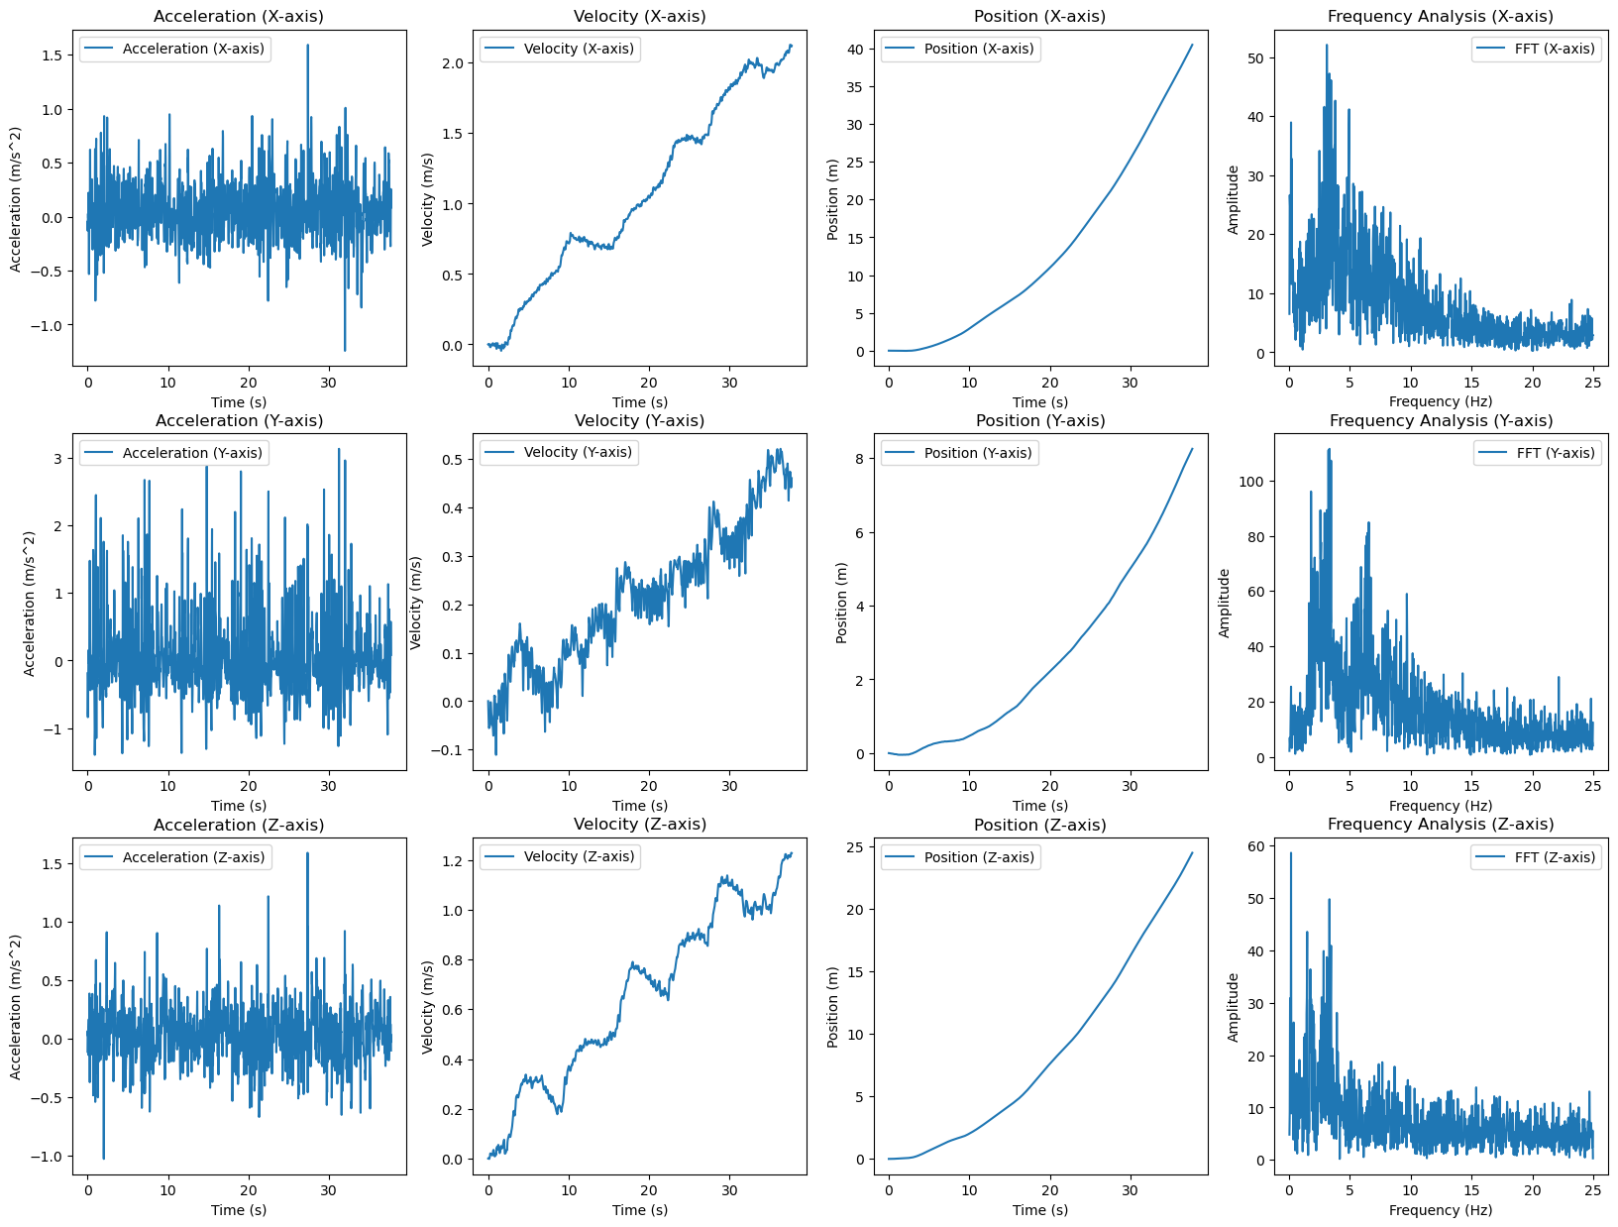
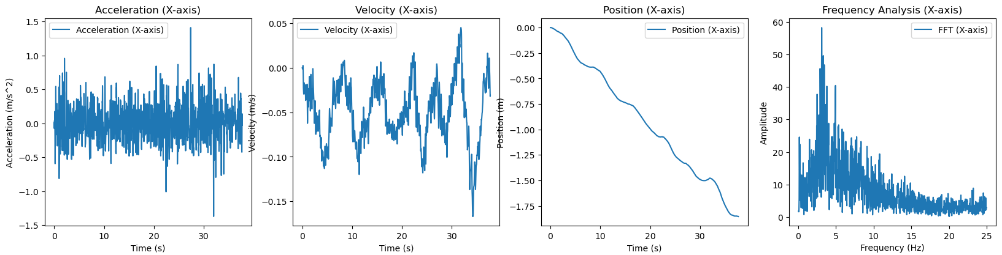

Slide 3
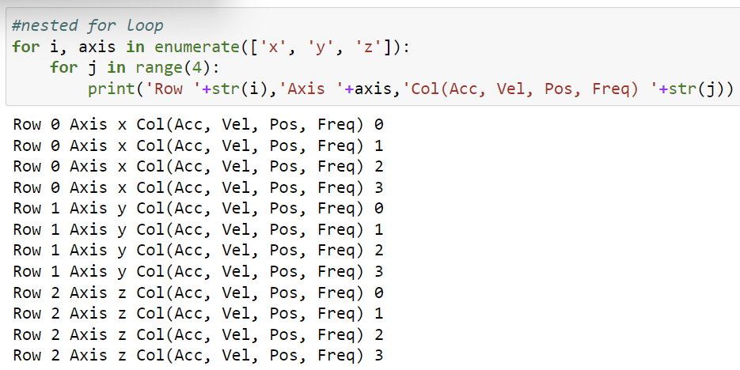
Technical part
nested For loop, create 3 by 4 grap
X
Freq

